Slide 1
Debugging

Slide 2
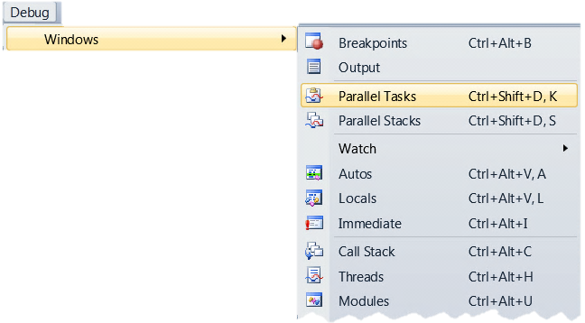
Parallel Debugging in VS2010
Two new debugger toolwindows
Support both native and managed
“Parallel Stacks”
Call stacks of all threads or tasks
“Parallel Tasks”
Scheduled, Running and Waiting
Notes:
See notes on all other slides

Slide 3
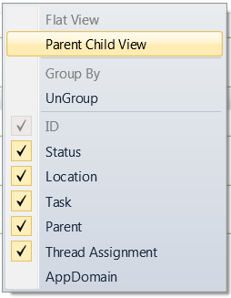
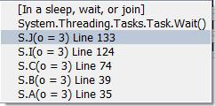
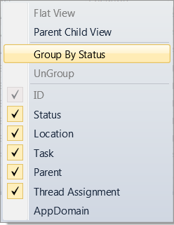
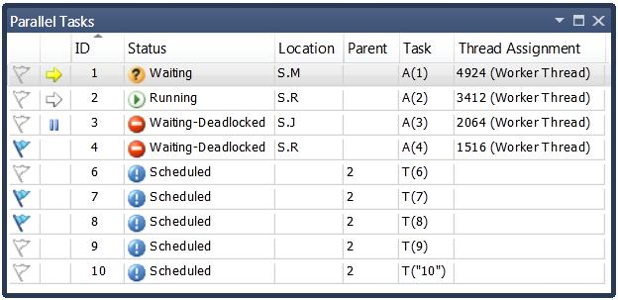
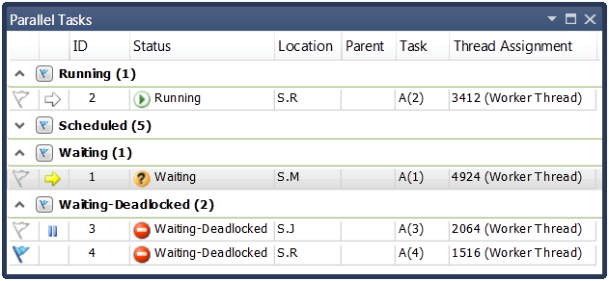
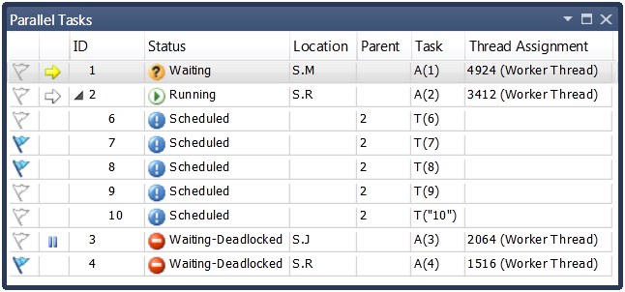
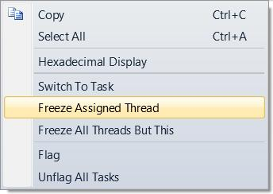

Parallel Tasks
Thread Assignment
Location + Stacktip
Parent ID
Status
Task Entry Point
Identifier
Current Task
BreakingTask
Task’s thread
is frozen
Column contextmenu
Flagging
Tooltip shows info on waiting/deadlocked status
Item contextmenu
Notes:
You can see all your tasks: running, waiting or scheduled, uniquely identified by their ID and further mapped to code via their Entry Point function, shown under the Task column.
For Running and Waiting tasks you can see the Location (inc. full real call stack of a task in a tooltip of that column) and the underlying thread information (under the Thread Assignment column).
For a Waiting task, you can see what it is waiting on (via the tooltip on the Status column) and if it is potentially deadlocked (via the icon).
You can easily identify (via the Parent column) and visualize (by using the menu to switch) parent child relationships between tasks. You can also group tasks (via the menu) based on a property of interest…
The new debugger toolwindow is truly integrated into the debugging experience, as expected from previous versions of Visual Studio. In particular, users of the old Threads window will feel at home with familiar features such as toggling hexadecimal display, same icons and concepts (e.g. current task/thread, frozen thread, flagging) and sharing of same settings for formatting display of call stacks.

Slide 4
Helps answer questions
What threads are executing my tasks?
Where are my tasks running (location, call stack)?
Which tasks are blocked?
How many tasks are waiting to run?
Notes:
http://www.danielmoth.com/Blog/2009/05/parallel-tasks-new-visual-studio-2010.html

Slide 5
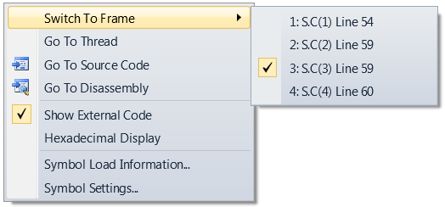
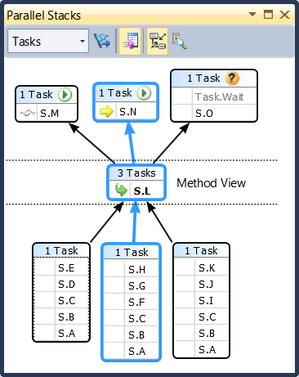
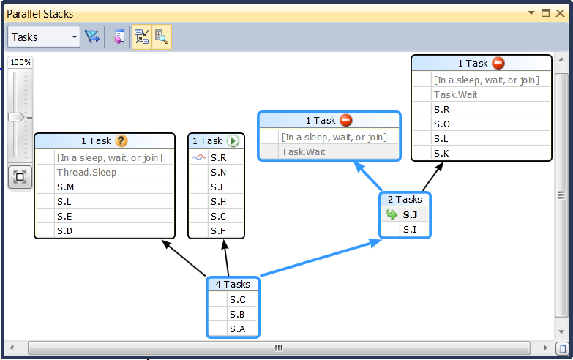


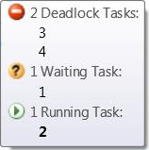

Parallel Stacks
active frame of
current thread
Context menu
active frame of
other thread(s)
current frame
Zoom
control
method tooltip
header tooltip
Bird’s eye view
Blue highlights path of current thread/task
Notes:
You can view all the call stacks of all the threads in a single view, including easy matching of a call stack to a thread ID (via tooltips).
You can easily distinguish the current thread (and stack frame) from all other threads (and stack frame) via the familiar icons.
You can navigate anywhere in the executing code by switching the stack frame (that drives the rest of the IDE). If you do the same from other places in the IDE, the Parallel Stacks window also reflects the change.
Common stack frames between threads (at the root of the call stacks) are coalesced together into call stack segments. This results in better use of screen real estate, as well as easy identification of "interesting" methods to focus on.
Common stack frames between threads (that have not been coalesced into the same call stack segment), are easily identifiable (bold). The developer can pivot on any method contexts via the Method View view (on the toolbar).
In addition to all of the above, the developer can switch the view to shows call stacks of tasks (instead of threads). In this Tasks view of the Parallel Stacks window, Threads that do not execute tasks at this moment in time are filtered out and the call stacks of threads executing tasks are trimmed on both ends so as to show only the real call stack as is relevant to the task. Also, call stacks of Threads executing more than one task are split to distinctly show the tasks on the view. Finally, thread information is replaced by task id information including the status.
In either view (Tasks or Threads) you can filter down the threads/tasks by showing flagged only threads/tasks. Flagging occurs in the Threads and Parallel Tasks windows respectively.
This new debugger toolwindow is truly integrated into the debugging experience, as expected from previous versions of Visual Studio. In particular, users of the Call Stack windows will feel that the Parallel Stacks is a natural extension.

Slide 6
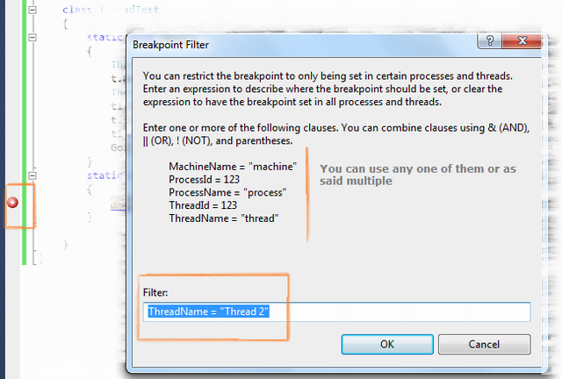
Setting Per thread breakpoints

Slide 7
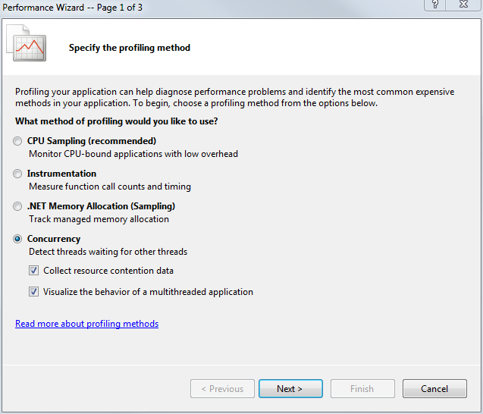
The Concurrency Visualizer
Notes:
To use the Concurrency Visualizer, Visual Studio must be started with Administrator privileges. To
do this, find Visual Studio in your Start menu, right-click it, and select “Run as administrator”. Load your
project, and select Start Performance Analysis from the Debug menu.

Slide 8
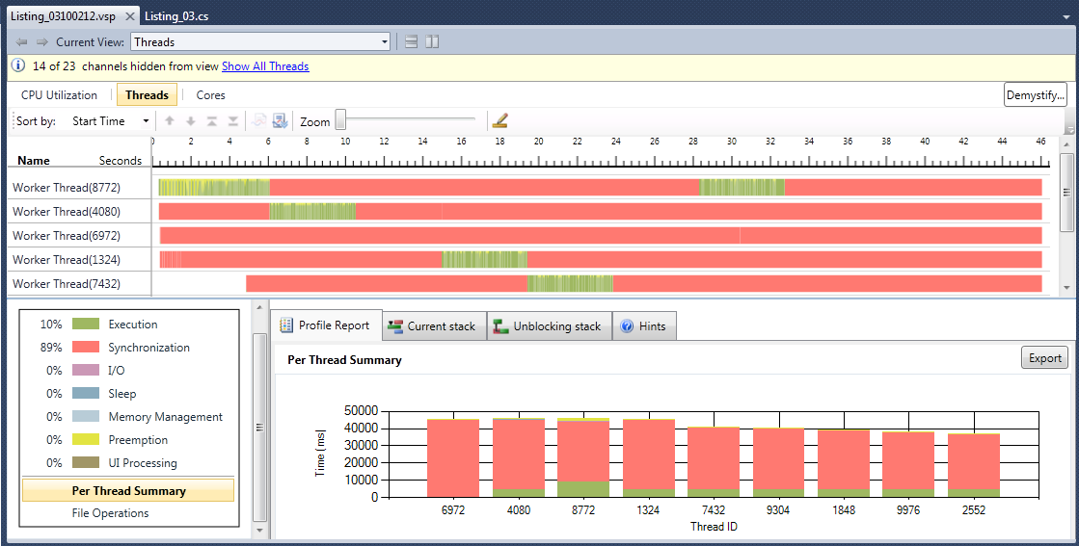

Slide 9
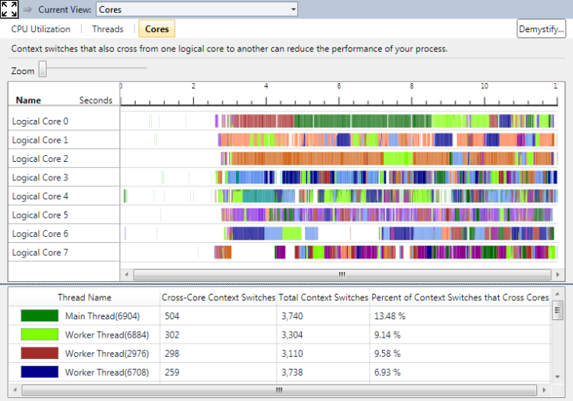

Slide 10
Appendix

Slide 11
It is a general Windows concurrency tool and not really tailored for task-oriented .NET programming.
Notes:
While the Concurrency Visualizer can be useful, it has some major limitations when you’re trying to
dig into the performance of a TPL program. It is a general Windows concurrency tool and not really
tailored for task-oriented .NET programming. Still, with some care and effort, it can be used to give an
overview of how your program is executed.

Slide 12
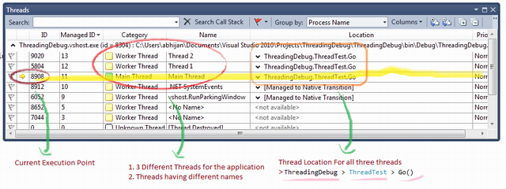
Tip #2: Use the Threads Debug Window
Notes:
You can open this window by clicking Debug->Windows->Threads or Ctrl+D, T in a debug session. In this window you can see the number of threads open for your application. You can also switch between threads by double clicking on a line in the table.

Slide 13
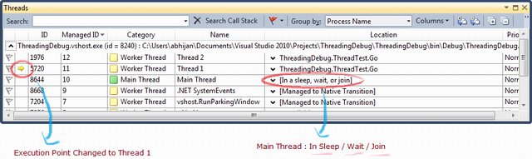

Slide 14
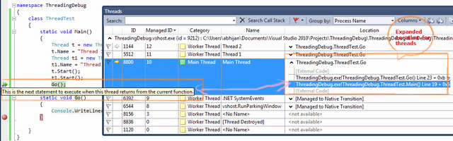

Slide 15

Tip #1: Always Name Your Threads
Notes:
Whenever you create a thread, remember to always give a name to it.

Slide 16
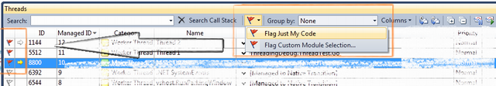
Flag Just My Code
Notes:
The sample code which I have explained for the thread debugging is very simple. What will happen if you have a huge code block with multiple number of threads. Then it will be very difficult for you to identify which thread is part of your code or which ones are not related. Thread window gives you very easy features to set the "Flag" for all the threads which are part of your code. For that, you need to just flag your thread by option "Flag Just My Code".

Slide 17
We could transform a complex multi threaded application into a single-threaded application without making changes to the code.
Notes:
We suspended the execution of the concurrent threads that would disturb our step-by-step execution. Thus, we could focus on the code being executed by just one encryption thread.

Slide 18
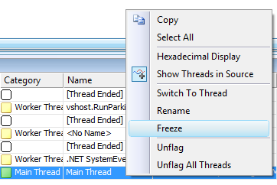
Freezing and thawing threads
Notes:
Freezing a thread suspends its execution. However, in the debugging process, we would need to resume the thread execution.

Slide 19
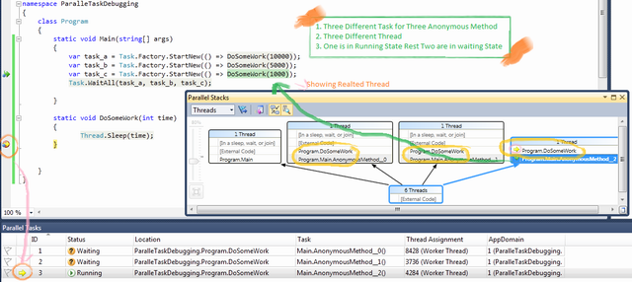
Parallel Task and Parallel Stack

Slide 20
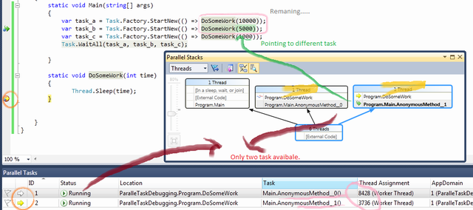

Slide 21
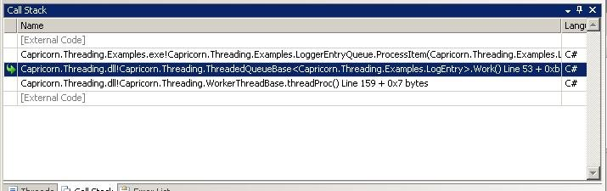
Tip #3: Use the Call Stack Debug Window
Notes:
You can open this window by clicking Debug->Windows->Threads or Ctrl+D, C in a debug session. In this window you can see the different methods that got called before reaching the current breakpoint location. Each line in this table corresponds to a Stack Frame. You can double click a line in this window to view the corresponding method in that stack frame.

Slide 22
Tip #4: Use the Debug Location Toolbar
Notes:
You can open the debug location toolbar by clicking View->Toolbars->Debug Location. This toolbar is the one that displays the Process, Thread and Stack Frame of the method being debugged.
You can also use this toolbar to switch between the live threads and navigate the call stack of the selected thread just like the Threads Debug Window and Call Stack Debug Window.

Slide 23
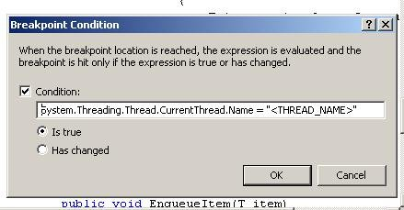
Tip #5: Use Conditional Breakpoints to Simulate Single-threaded Execution
Notes:
Choose strategic points where you want to inspect the state of the thread. Create breakpoints in the selected locations. On each of the breakpoints, click Right-Mouse-Button->Condition. In the textbox where you are supposed to enter a condition, enter
System.Threading.Thread.CurrentThread.Name = "<THREAD_NAME>".
Where <THREAD_NAME> is equal to the name of the thread you wish to inspect.

Slide 24
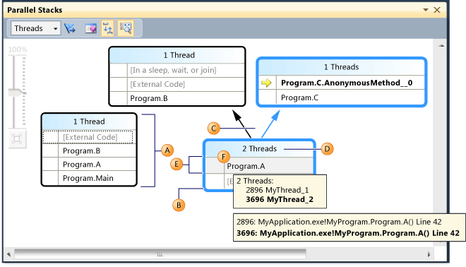
Call Stack
Notes:
A
Call Stack Segment or Node
Contains a series of method contexts for one or more threads. If the node has no arrow lines connected to it, then it represents the entire call path for the thread(s).
B
Blue Highlight
Indicates the call path of the current thread.
C
Arrow lines
Connect nodes to make up the entire call path for the thread(s).
D
Tooltip on Node Header
Shows the ID and user-defined name of each thread whose call path shares this node.
E
Method Context
Represents one or more stack frames in the same method.
F
Tooltip on method context
Shows details of all stack frames that the method context represents. Stack frames on the current thread are shown in bold.

Slide 25
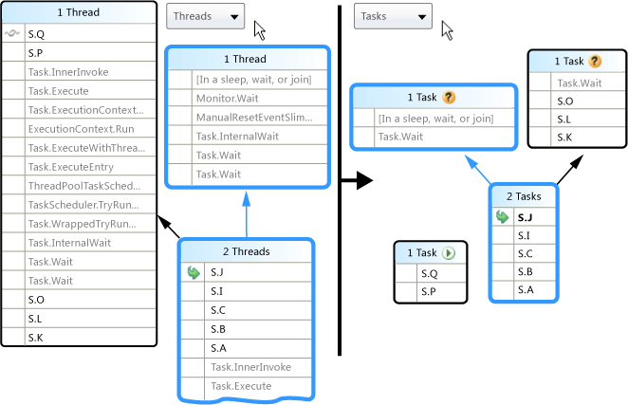
Thread View vs Task View
Notes:
Tasks View differs from Threads View as follows:
Call stacks of threads that are not running tasks are not shown.
Call stacks of threads that are running tasks are visually trimmed at the top and bottom to show the most relevant frames that pertain to tasks.
When multiple tasks are on one thread, the call stacks of those tasks are split out into separate nodes.

Slide 26
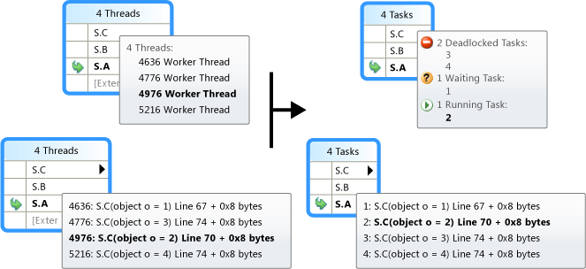
Notes:
by hovering over a node header or a method context, you can see additional information.

Slide 27
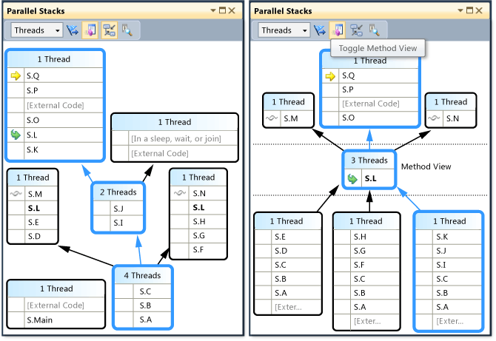
Method View
Notes:
From either Threads View or Tasks View, you can pivot the graph on the current method by clicking the Method View icon on the toolbar. Method View shows at a glance all methods on all threads that either call or are called by the current method. The following illustration shows a Threads View, and also how the same information looks in Method View.

Slide 28
Showing thread-safe output
System.Diagnostics.Debug.Print
Notes:
The System.Diagnostics.Debug.Print method allows us to show information at runtime from many threads in a thread-safe way. Using it, the application can provide us with very important feedback to understand what happens when multiple concurrent threads are running at the same time.
Running a multithreaded application step-by-step, even without isolation, does not represent the real concurrent execution that happens at runtime without breakpoints. Therefore, it is very important to have some feedback to test certain conditions using the System.Diagnostics.Debug.Print method.
However, we must remember that the application's performance will degrade when using the System.Diagnostics.Debug.Print method. Thus, the performance must be measured without calls to this method or any interfering debugging techniques.
Using this method, combined with all the debugging techniques known for single-threaded applications, such as inspecting values, setting breakpoints, and tracepoints, we will not have any trouble in solving bugs in multithreaded code.

Slide 29
Parallel Visualization Pack for Visual Studio 11 Developer Preview.
Heat Map The Heat Map displays values on either a clustered, linear or logarithmic scale, to help spot uneven distribution of data across threads.
Histogram A graph that groups the value of an expression with the number of occurrences across threads. It also allows the user to display any undefined values in the application.
Scatterplot This visualizer creates a graph of data on an x-y axis to help spot outliers.
Object Expander The Object Expander lets the user drill down into all the members of an object in the Parallel Watch Window, and compare the values across threads. Values or entire threads can be flagged and sorted. Default selections include max, min, unique, and undefined values.

Slide 32
Design the application so that it can run sequentially. An application should always have a valid means of sequential execution. The application should be validated in this run mode first. This allows developers to eliminate bugs in the code that are not related to threading.

Slide 33
. Try to isolate mutable objects to a single thread, and then carefully control the exchange of mutable objects between threads. Attempt to program with a design of object hand-over, rather than "shared" objects.

Slide 34
Race conditions tend to be extremely difficult to replicate,
Deadlocks are the easiest to debug

Slide 35

Method View
Notes:
Method View shows at a glance all methods on all threads that either call or are called by the current method.

Slide 36
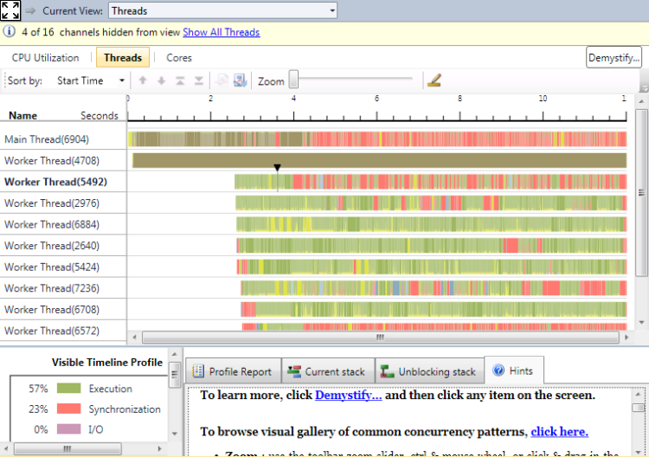

Slide 37
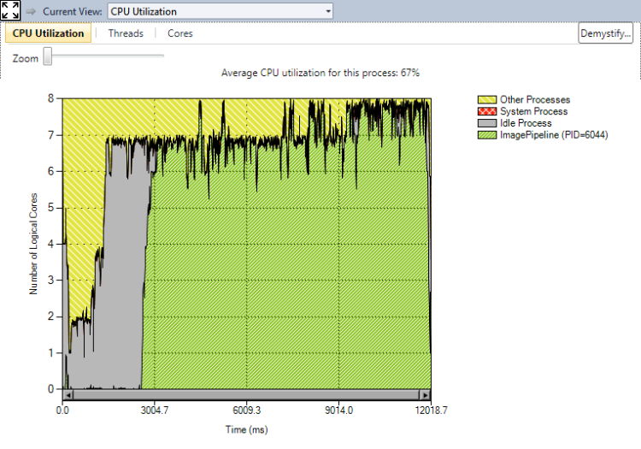

Slide 38
Performance counter

